Slide 1
3D Crane and 2D Plate Analysis Utilizing Finite Element Method

Slide 2
CONTENT
THE METHOD
3D truss Crane and frame (truss – beam) Crane
2D Plate with Hole
Optimization of the Results
General Conclusions

Slide 3
FINITE ELEMENT METHOD
Before FEM: No solution for multiple real problems
Development of FEM : Need for more accurate numerical solutions
FEM Structure :
Combine all the solutions
Real Problem
Analytical Equations
SubSections – SubProlems
Analytical solutions in each subsection
Total Solution

Slide 4
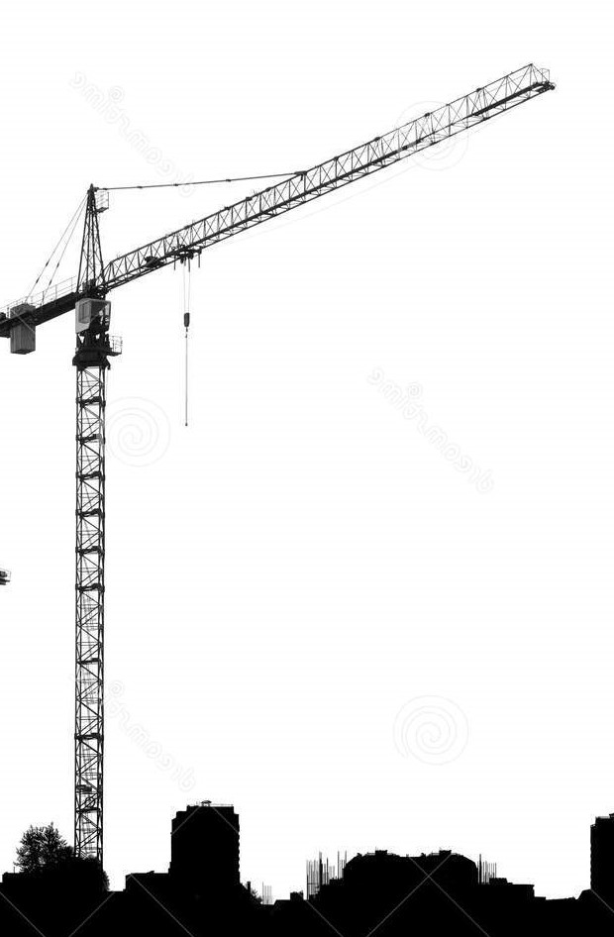
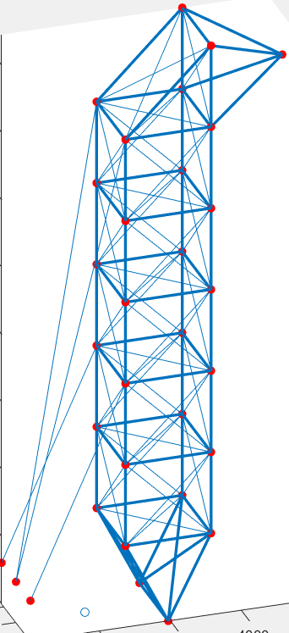
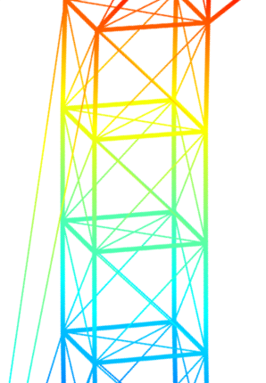
FINITE ELEMENT METHOD
Structure
Modelling
Calculations - Vsualization

Slide 5
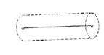
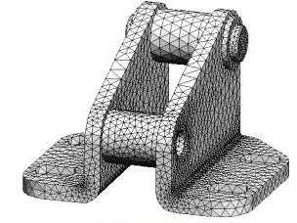
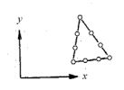
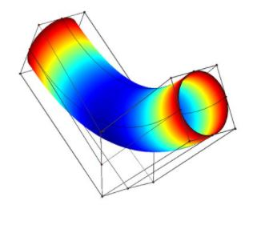
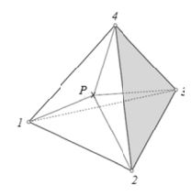
FINITE ELEMENT METHOD
Application
Choose element type
Discretization
FEM functions
Solve
Linear
Polynomial
Exponential
Visualization

Slide 6
FINITE ELEMENT METHOD
Preprocessor
Solver
Postprocessor
Property Matrices
Solve Equations
Calculation of stresses, strains etc.
Visualization
Data
Nodes
Elements
Modelling
Forces
Boundary Conditions

Slide 7
3D TRUSS AND FRAME CRANE ANALYSIS
The Problem
Results

Slide 8
PROBLEM
Structure : Truss
3 DOFs
tensile
compression
Axial deformation
Structure : Lifting Crane
Compute :
Displacements
Strains
Stresses
Forces
Visualize : Results
Κατασκευή : frame
Truss and Beams
6 DOFs
tensile
compression
bending
Horizontal and Vertical Deformation

Slide 9
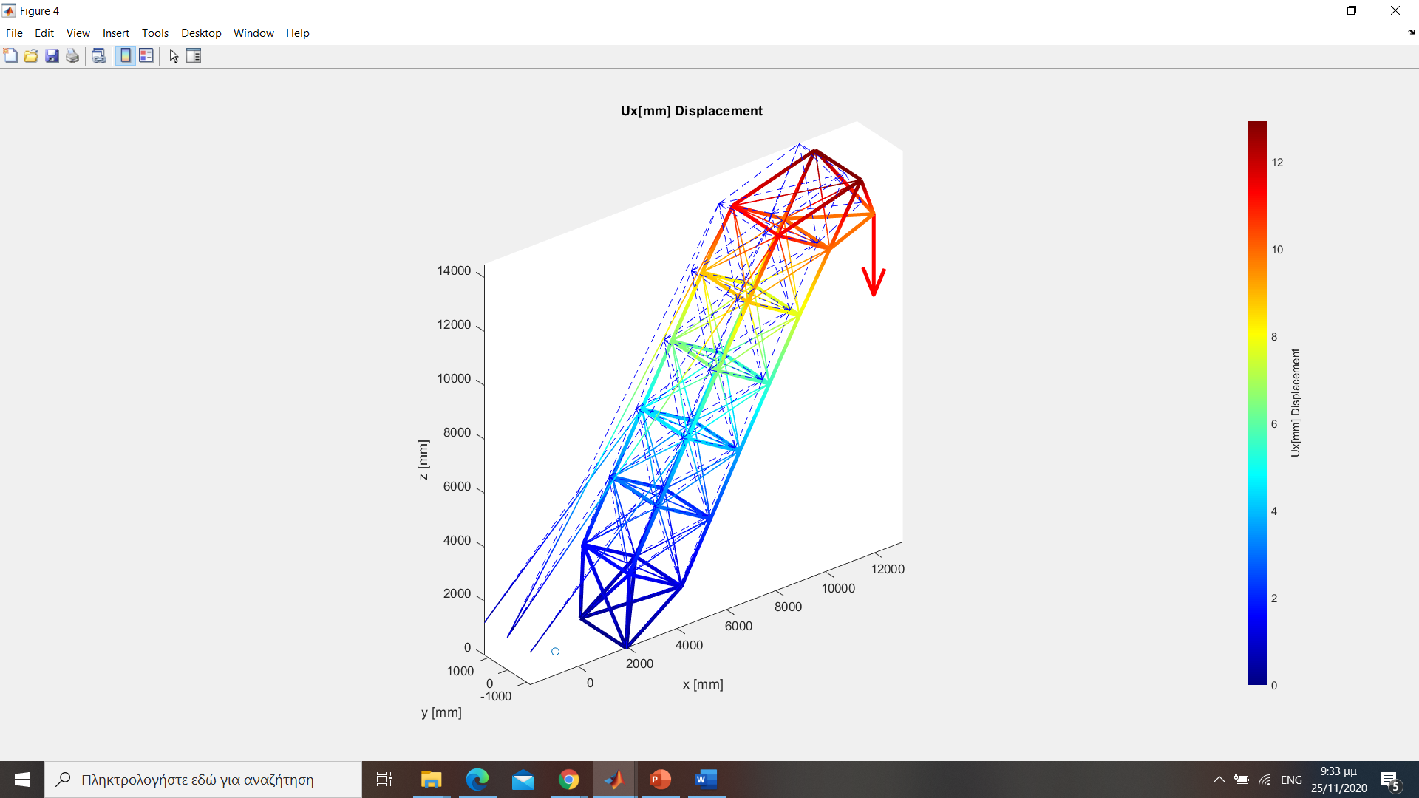
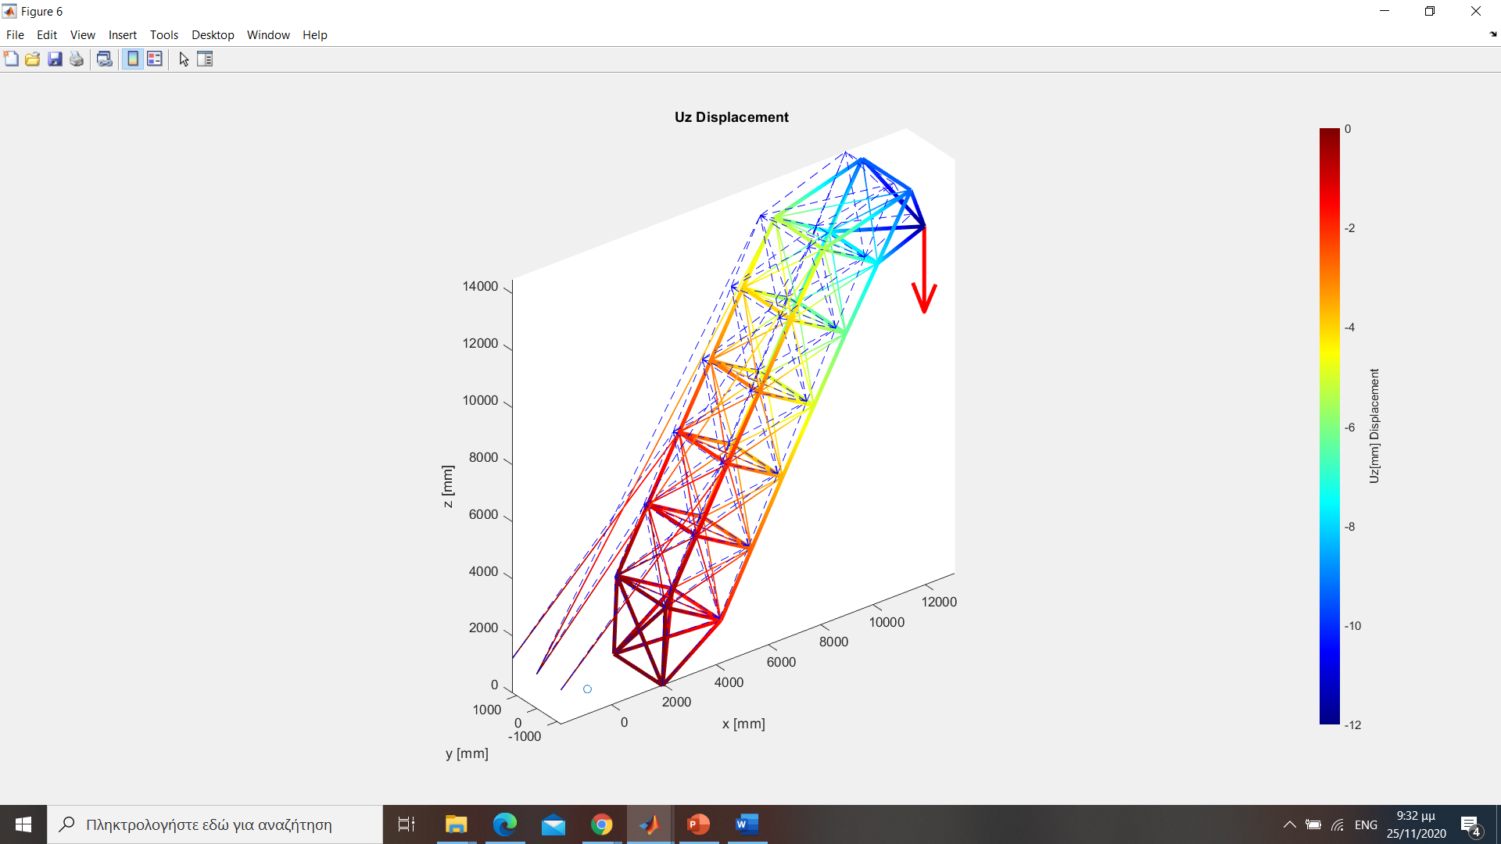
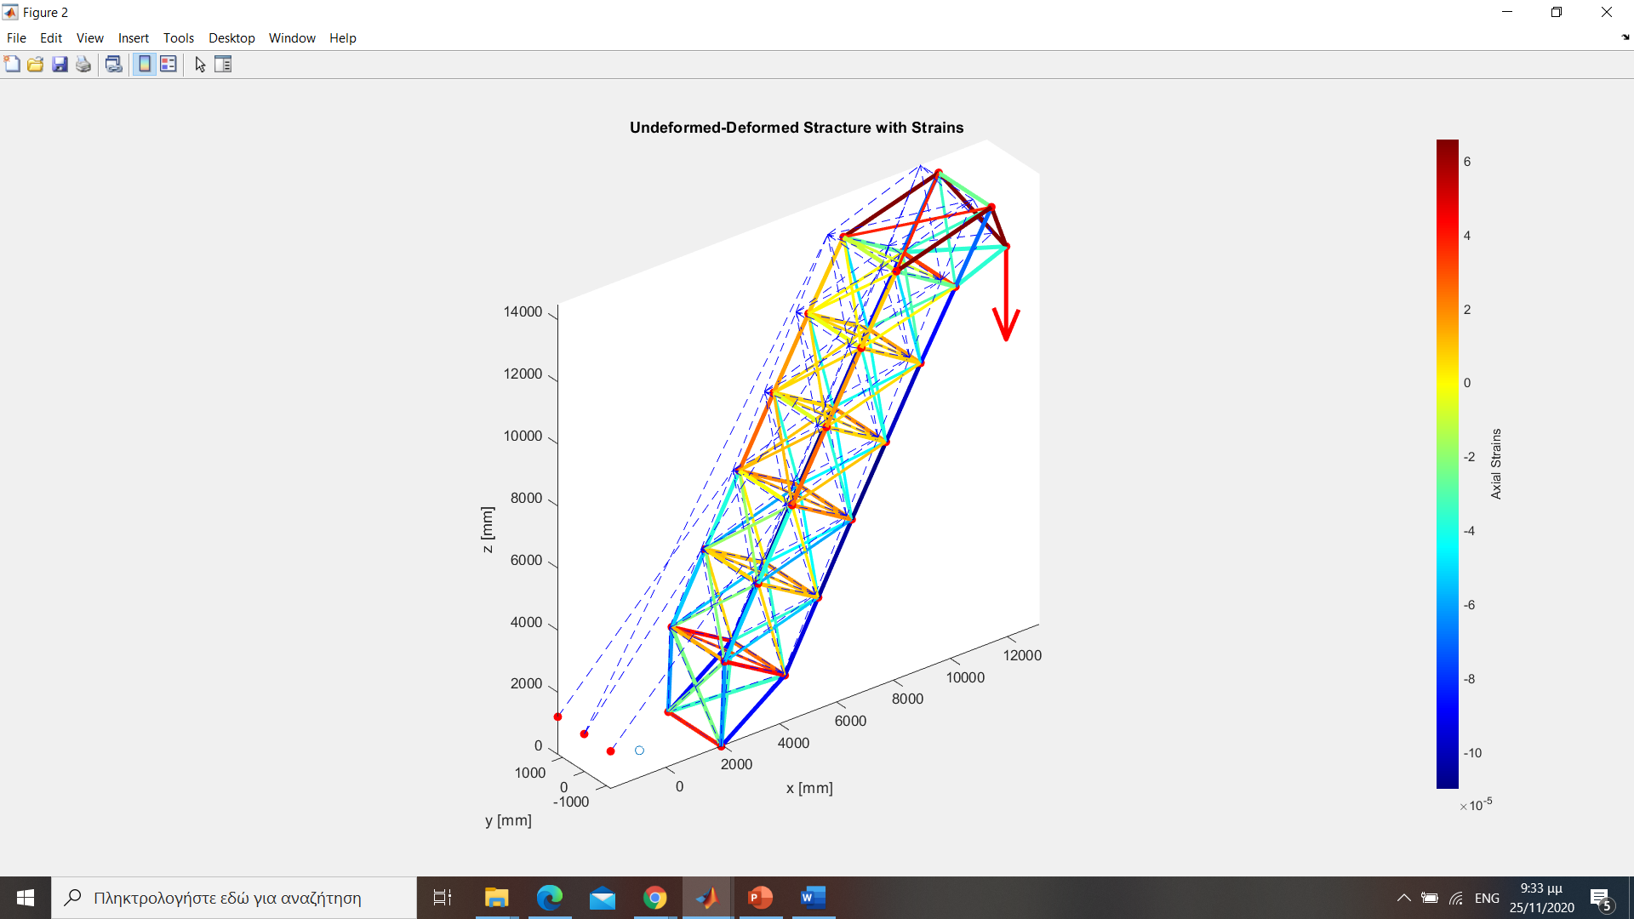

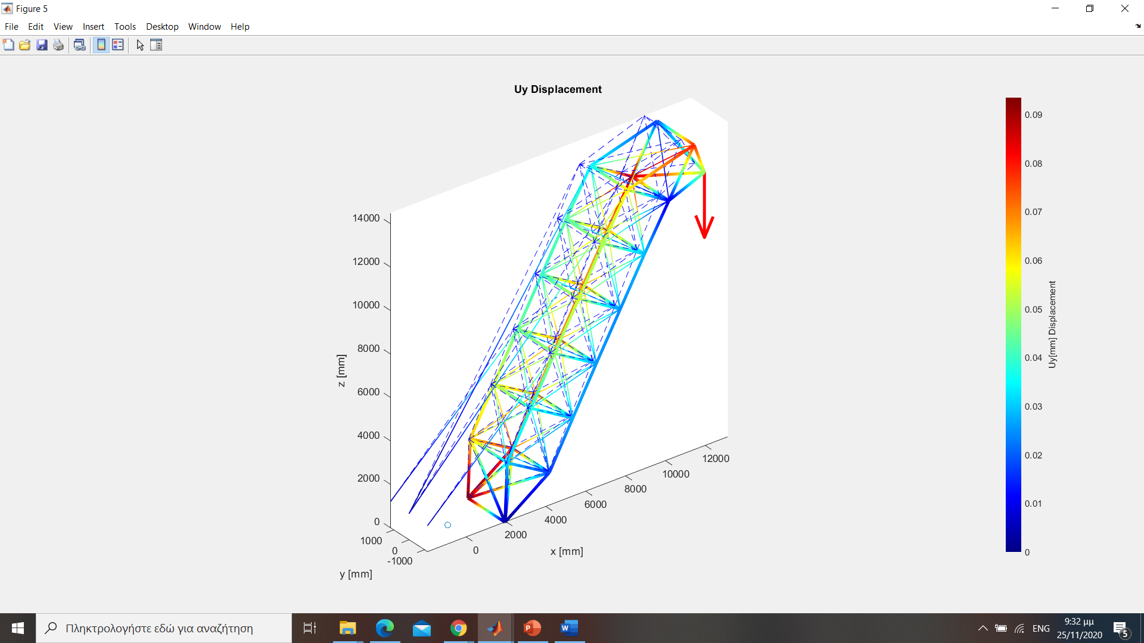
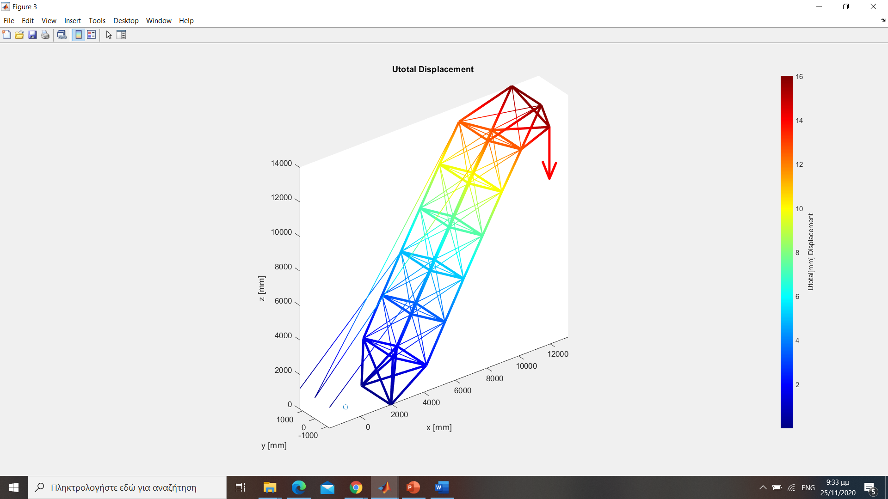
ΑΠΟΤΕΛΕΣΜΑΤΑ-ΣΥΜΠΕΡΑΣΜΑΤΑ
F=-20kN
Στοιχεία :Ράβδοι
Αξονικές Παραμορφώσεις
Αξονικές Τάσεις

Slide 10
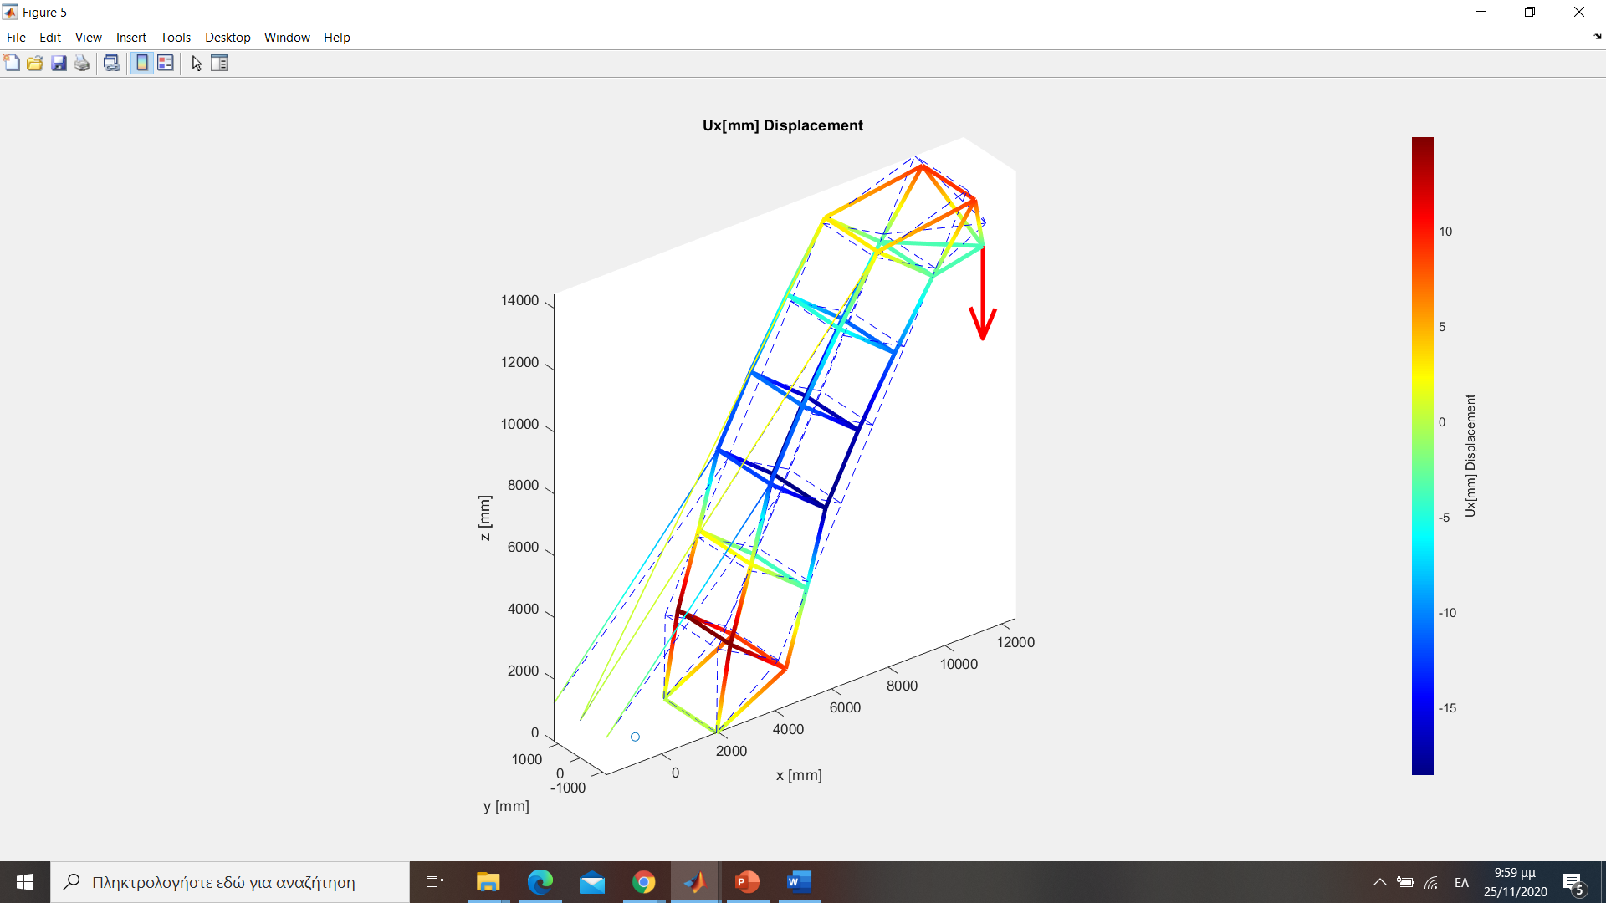
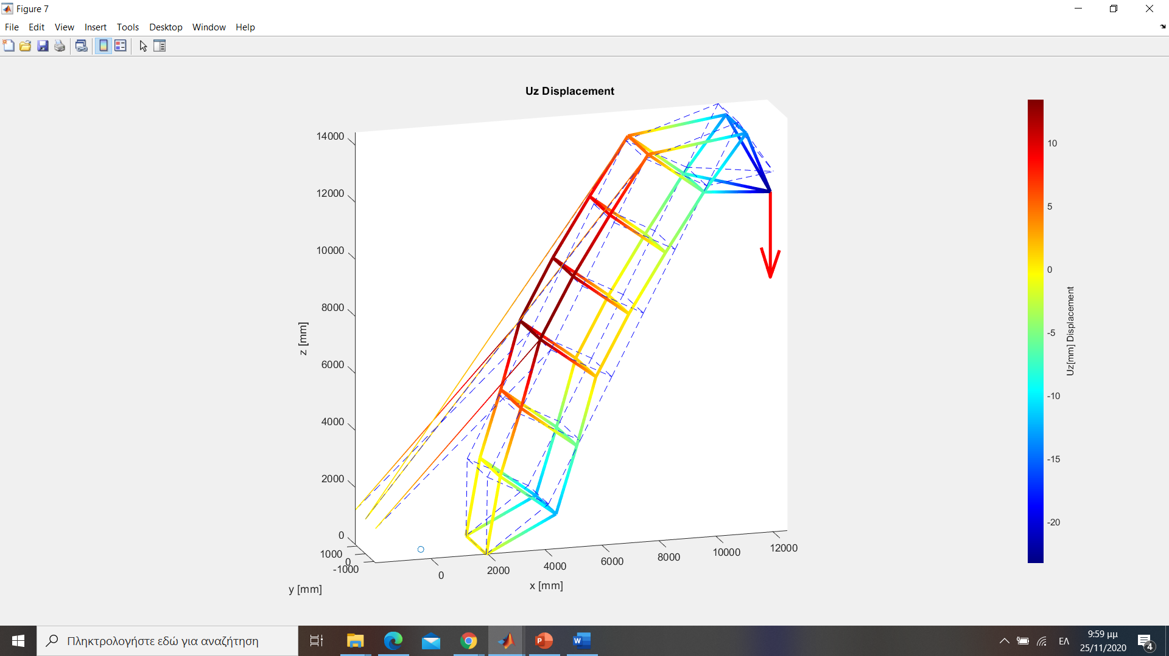
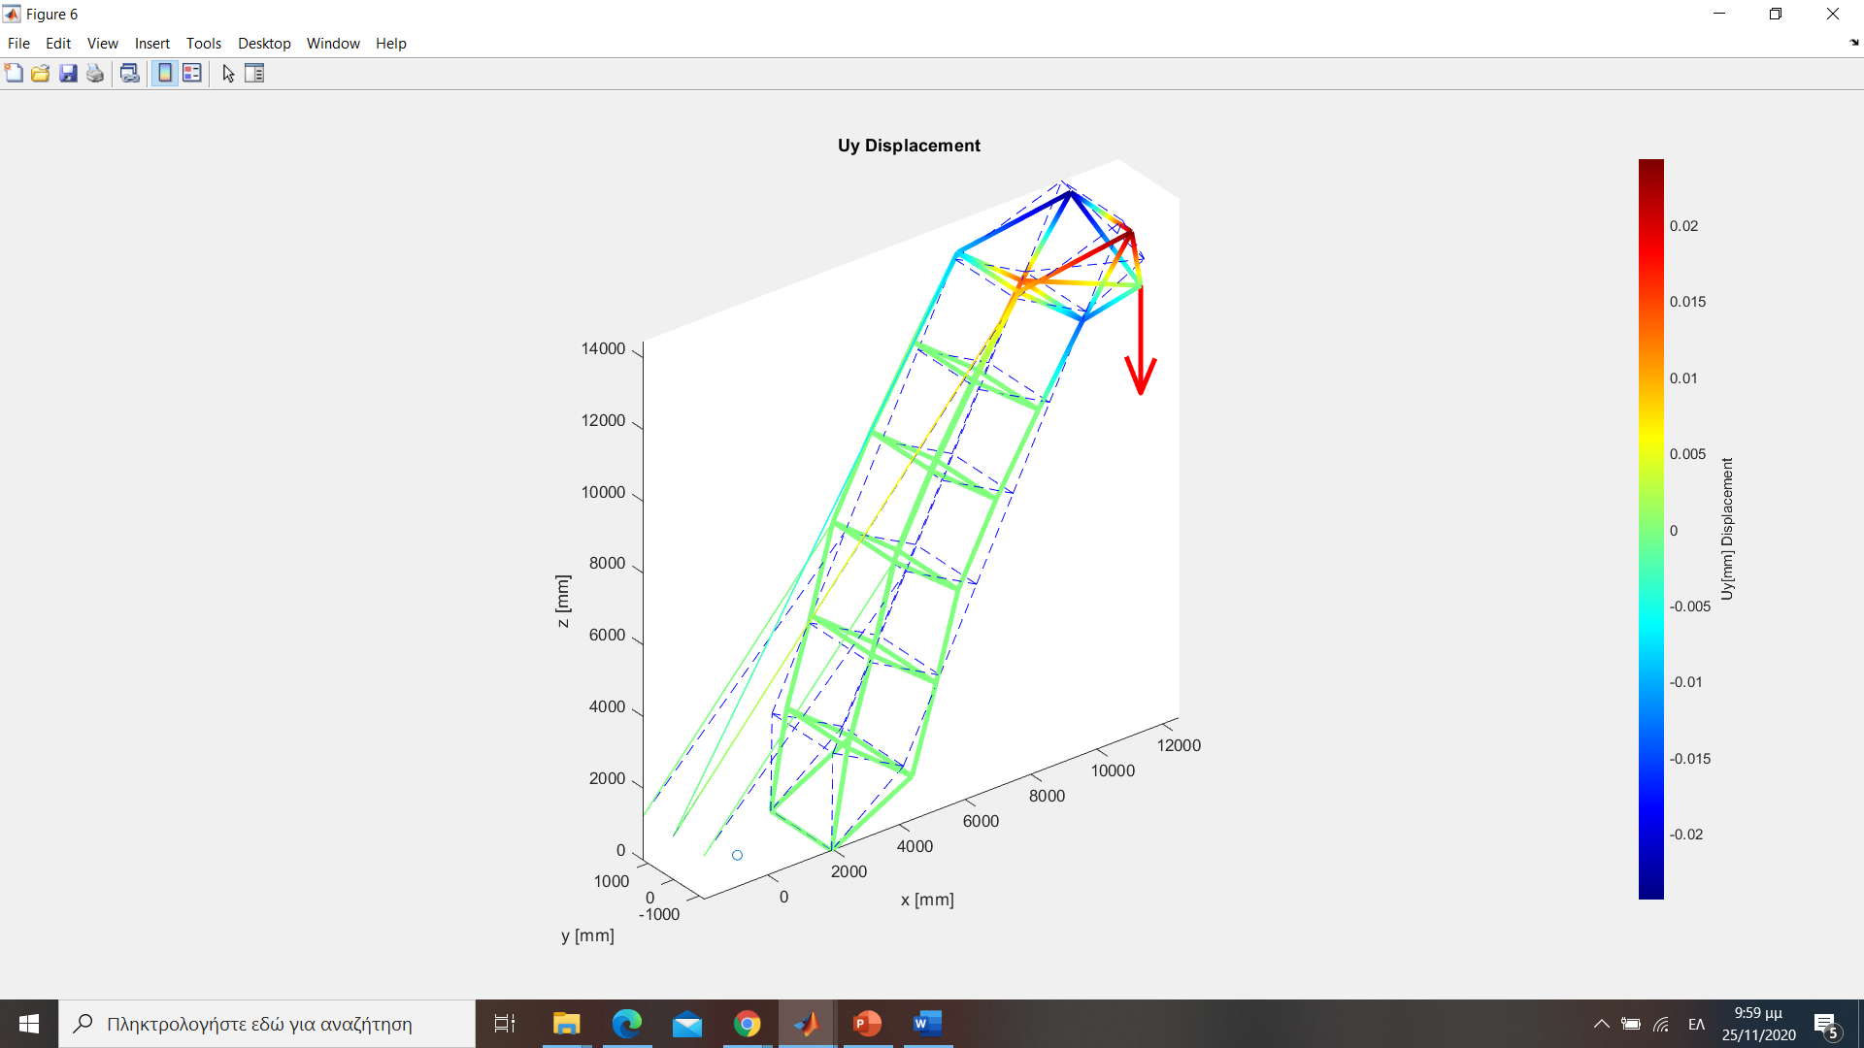
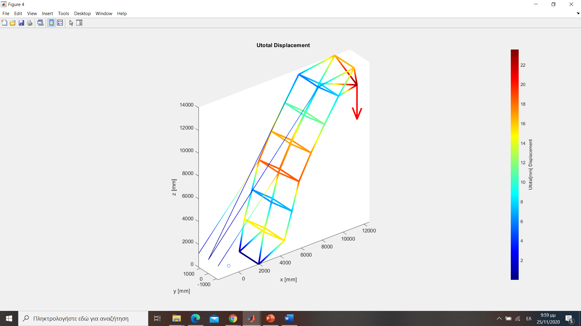
ΑΠΟΤΕΛΕΣΜΑΤΑ-ΣΥΜΠΕΡΑΣΜΑΤΑ
F=-20kN
F=-20kN
Στοιχεία : Ράβδοι και Δοκοί (Πλαίσιο)

Slide 11
ΑΠΟΤΕΛΕΣΜΑΤΑ-ΣΥΜΠΕΡΑΣΜΑΤΑ
Scale factor = 90
Scale factor = 25
F=-20kN
F=-20kN

Slide 12
2D PLATE WITH HOLE
Problem
Hole Factor
Results
Post – Process results critical section

Slide 13
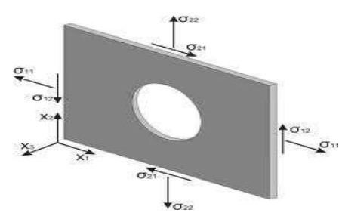
PROBLEM
3D Plate with internal hole
2D PLANE STRESS σ_{z} = 0
Tensile και One Axis Bending
Displacements : u_{x} , u_{y}
Strains : ε_{x} , ε_{y} , γ_{xy}
Stresses : σ_{x} , σ_{y} , τ_{xy} , σ₁ , σ₂ , σ_{ισ} (Von Misses)
Hole Factorsr k_{t}

Slide 14
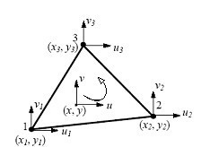
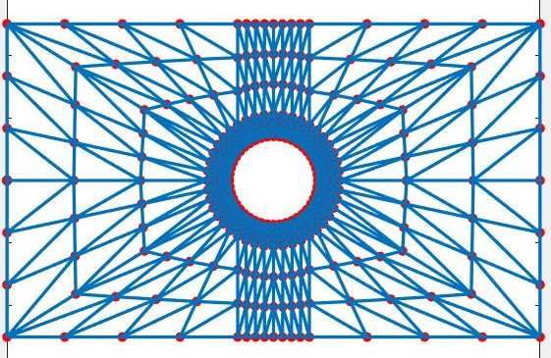
APPLICATION STEPS
Choose element type
Discretization
6 DOF
Easy to draw
Good adaptation
Solve
Visualize

Slide 15
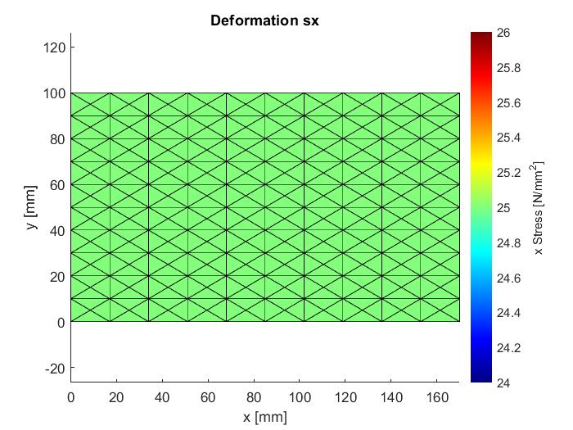
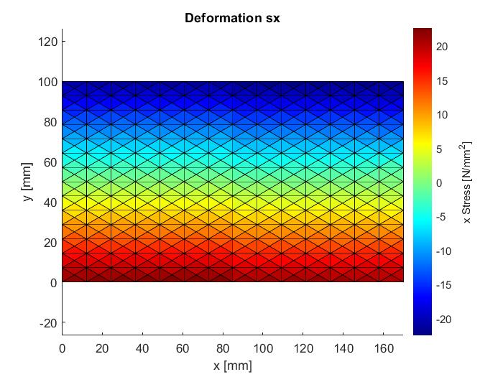
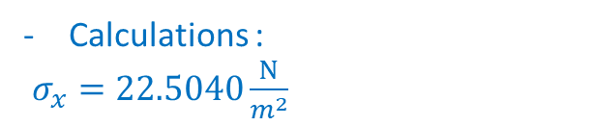

Reliability Check
Tension
Force F=10kN
- Theorytical : $σ_{x}=\frac{F }{H∗t } \underset{⇒}{ H=100,t=4}σ_{x} = 25\frac{Ν}{m^{2}}$
- Calculations : $σ_{x}=25\frac{Ν}{m^{2}}$
Bend
Bending Moment M=150.000Nmm
- Theorytical : $σ_{x}=\frac{M_{z} H}{2∗I_{z}} \underset{⇒}{ H=100,}σ_{x} =22.52\frac{Ν}{m^{2}}$
Calculations :
$σ_{x}=22.5040\frac{Ν}{m^{2}}$

Slide 16
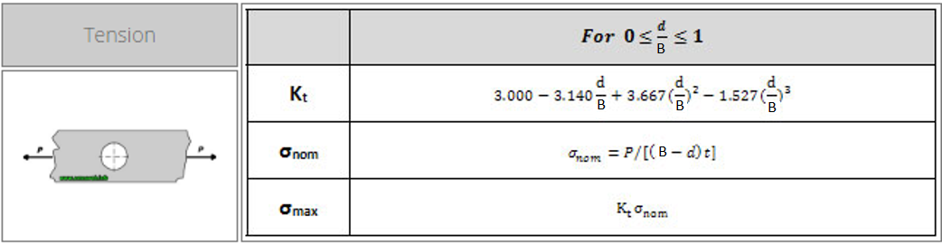
Hole Factor
High Stress concentrations
Large changes in geometry
Strength Reduction
TENSION
$k_{t}=\frac{σ_{max}}{σ_{ον}}$

Slide 17
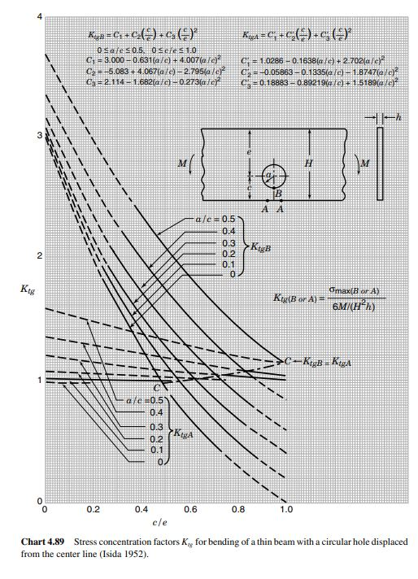
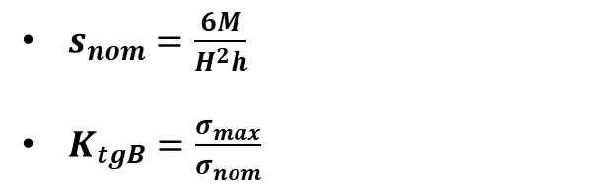
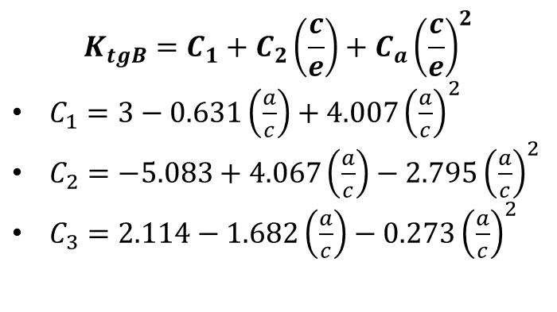
HOLE FACTOR
BEND
$$K_{tgB}=C_{1}+C_{2}\left(\frac{c}{e}\right)+C_{a}{\left(\frac{c}{e}\right)}^{2}$$
$C_{1}=3−0.631\left(\frac{a}{c}\right)+4.007{\left(\frac{a}{c}\right)}^{2}$
$C_{2}=−5.083+4.067\left(\frac{a}{c}\right)−2.795{\left(\frac{a}{c}\right)}^{2}$
$C_{3}=2.114−1.682\left(\frac{a}{c}\right)−0.273{\left(\frac{a}{c}\right)}^{2}$
$s_{nom}=\frac{6M}{H^{2}h}$
$K_{tgB}=\frac{σ_{max}}{σ_{nom}}$

Slide 18
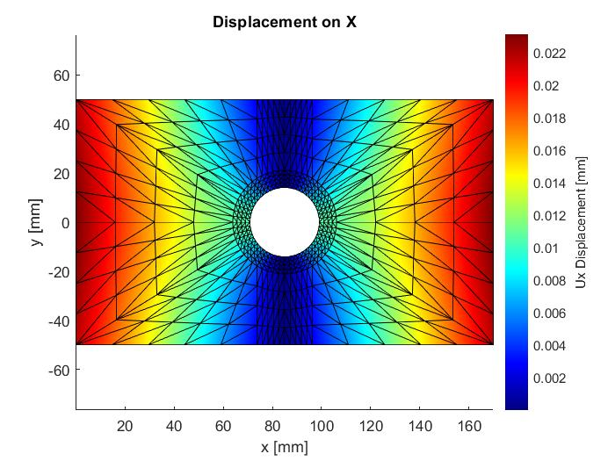
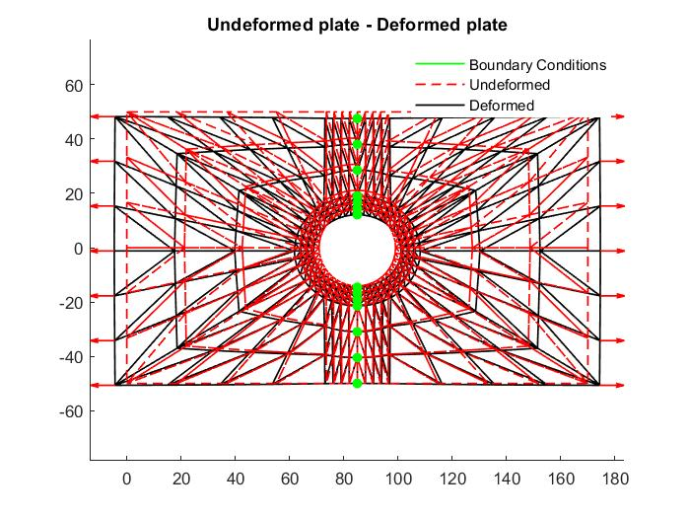
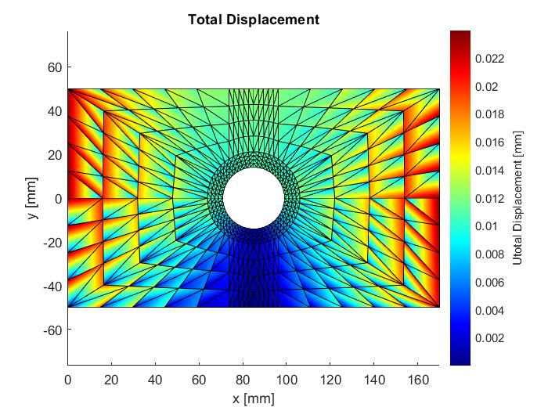
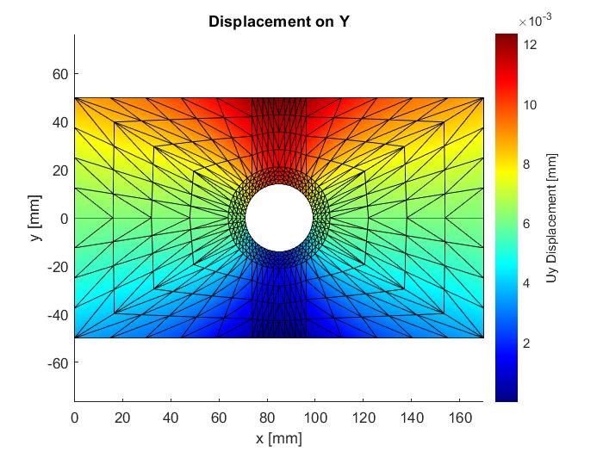
RESULTS - TENSION
Displacements
F =20kN

Slide 19
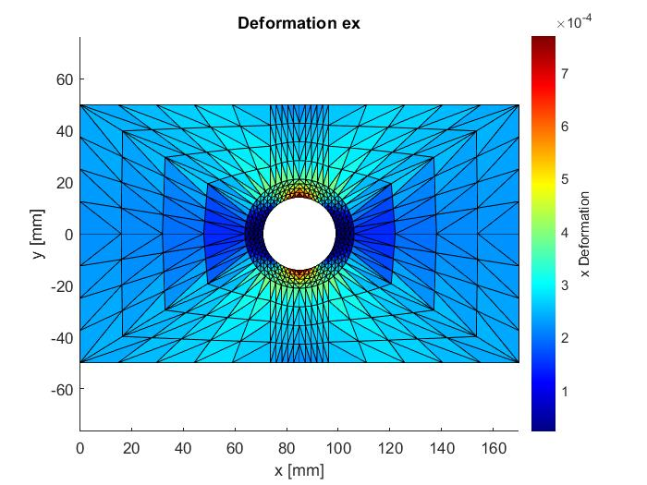
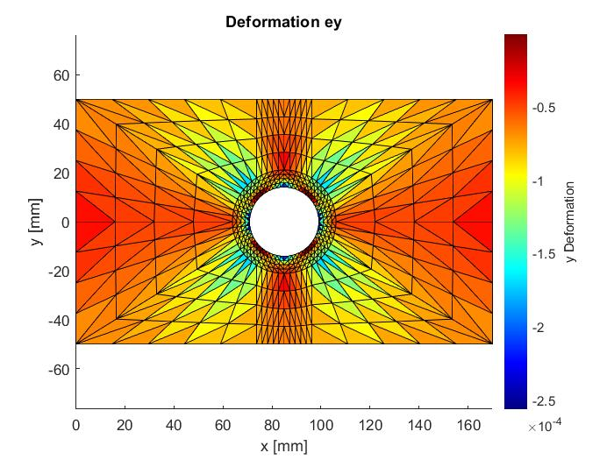
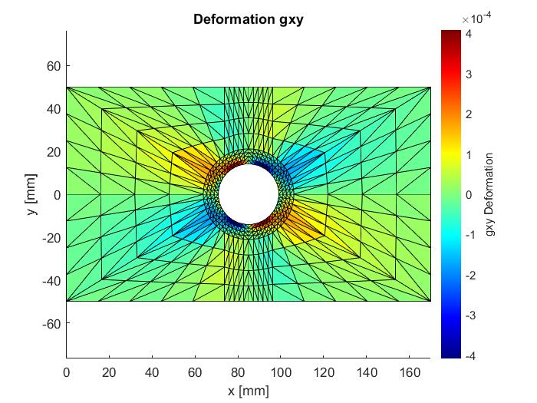
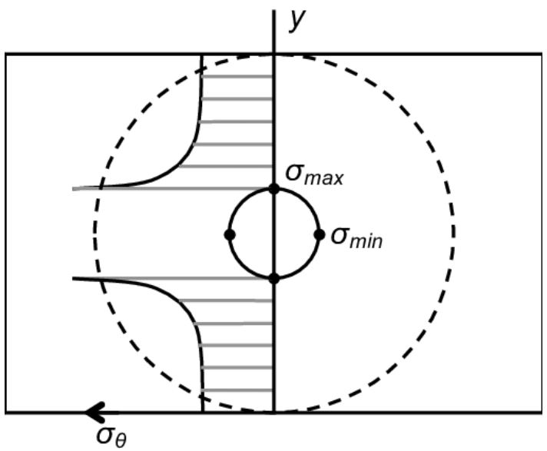
RESULTS - TENSION
Deforamtions

Slide 20
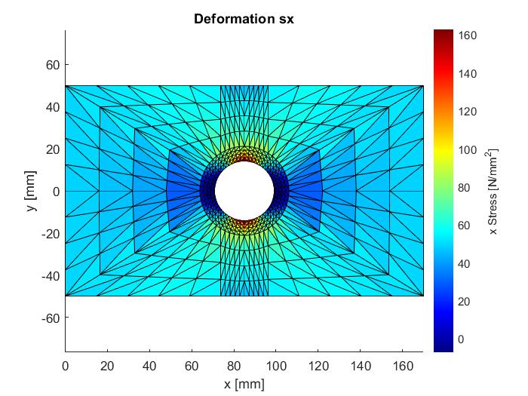
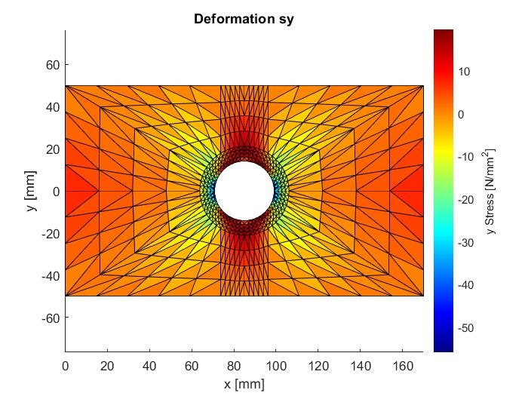

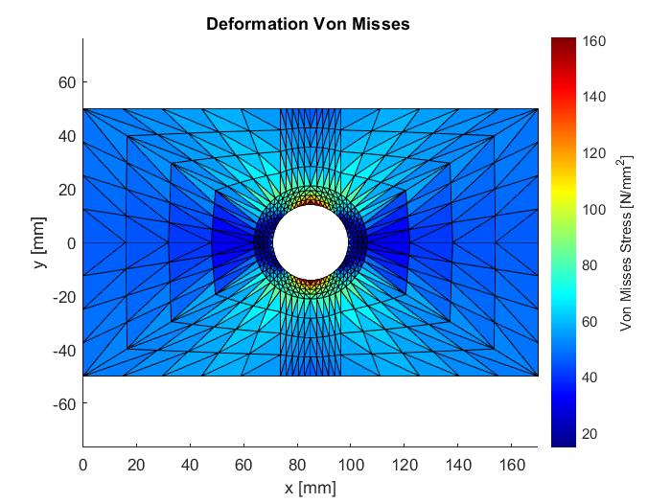
RESULTS - TENSION

Slide 21
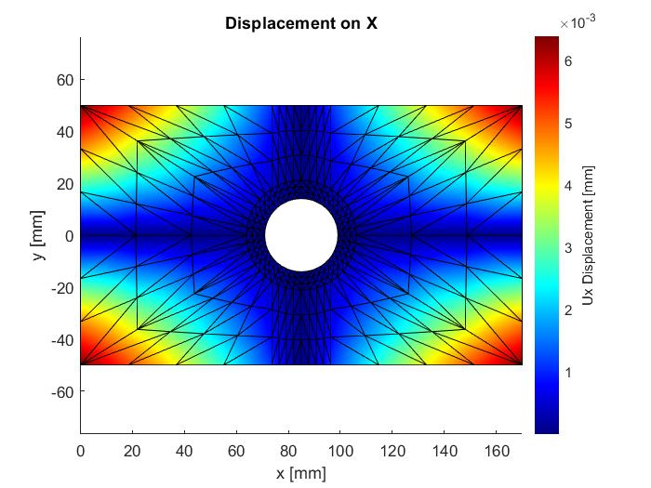
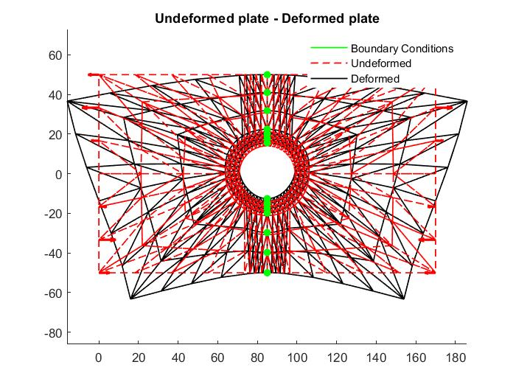
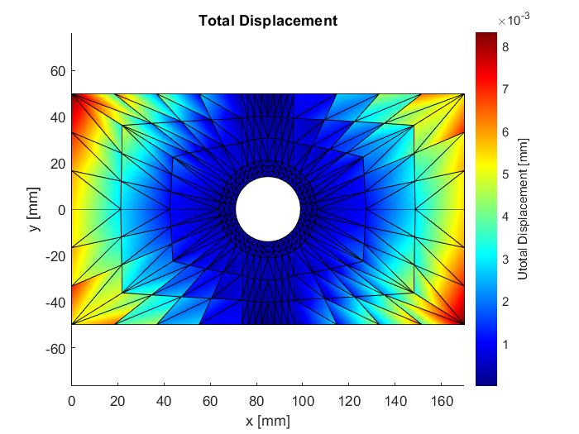
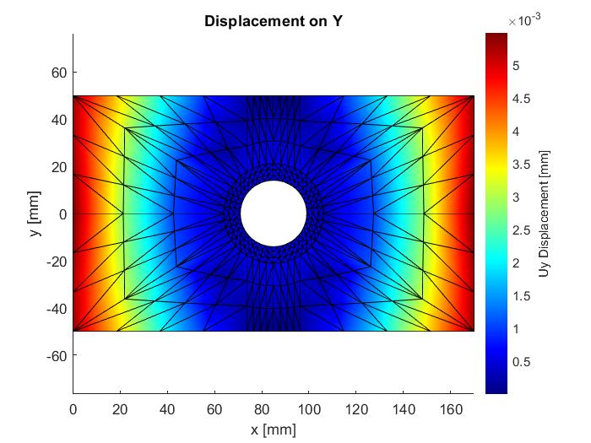
RESULTS - BENDING
Displacements
Μ =150 kNmm

Slide 22
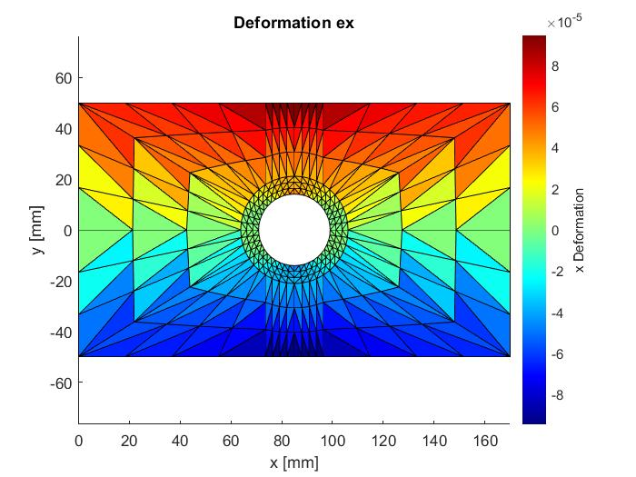
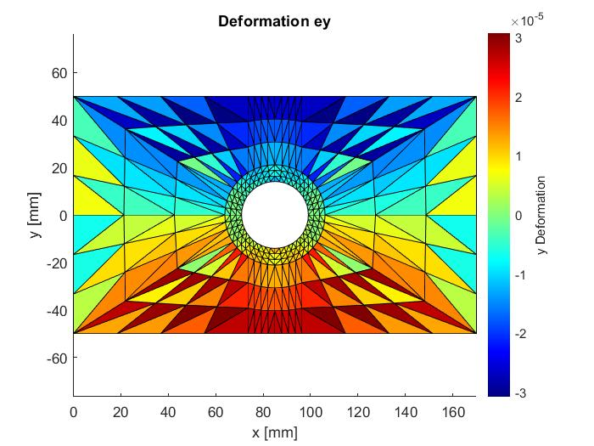
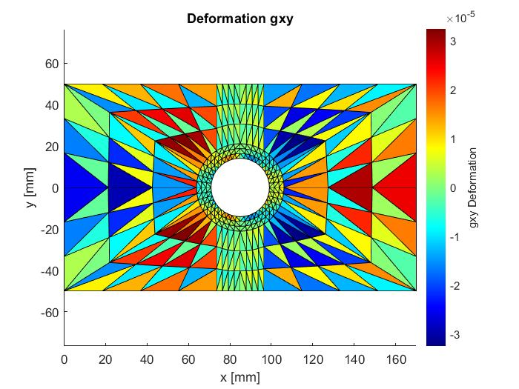
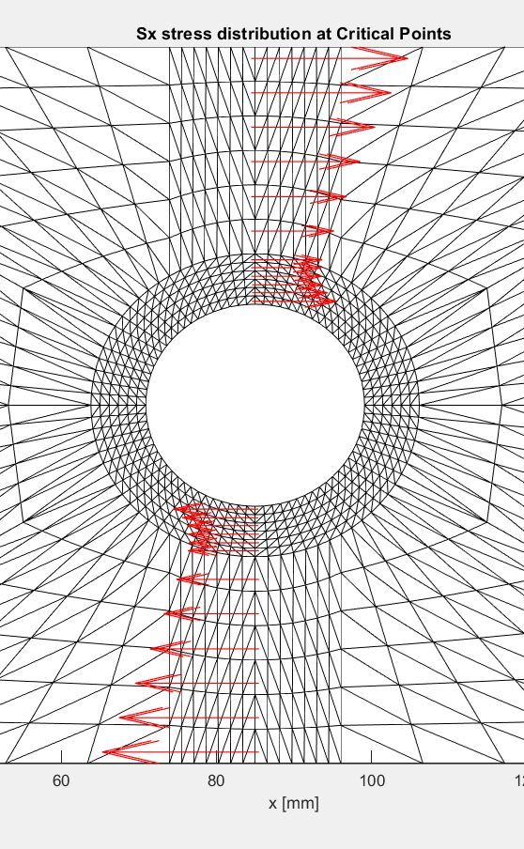
RESULTS - BENDING
Deformation

Slide 23
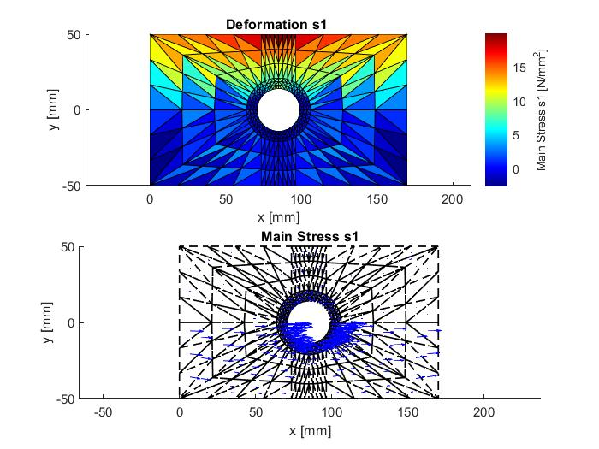
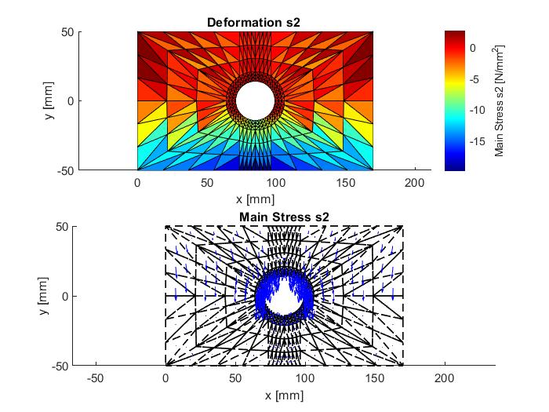
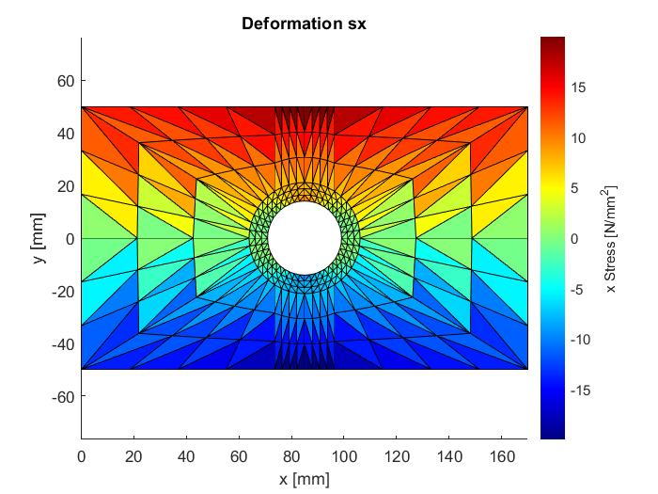
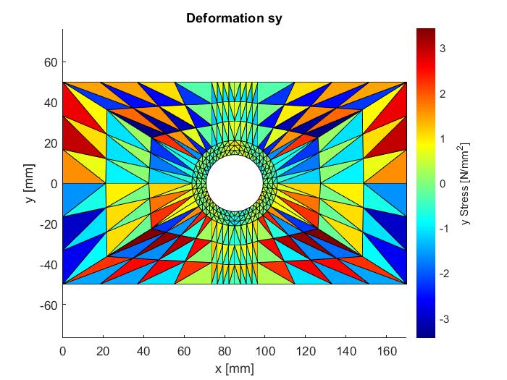


RESULTS - BENDING

Slide 24
POST – PROCESSING RESULTS FOR TENSION
Θεωρητικά
FORCE [kN] | 20
DIAMETER [mm] | 14,1
NOMINAL[N/mm2] | 69,63
MAX [N/mm2] | 165,1
Υπολοισμένα (Πριν)
NOMINAL[N/mm2] | 69,63
MAX [N/mm2] | 162,95
Υπολοισμένα (Μετά)
NOMINAL[N/mm2] | 69,63
Μέγιστη [N/mm2] | 173,8

Slide 25
POST – PROCESSING RESULTS FOR BENDING
Θεωρητικά
Ροπή [Νmm] | 150000
Διάμετρος [mm] | 14,1
Ονομαστική[N/mm2] | 22,5
Εγκοπής [N/mm2] | 13,5
Υπολοισμένα (Πριν)
Ονομαστική[N/mm2] | 22,5
Εγκοπής [N/mm2] | 11,28
Υπολοισμένα (Μετά)
Ονομαστική[N/mm2] | 22,5
Εγκοπής [N/mm2] | 11,94

Slide 26
HOLE FACTOR COMPARISON
COMPARISON
 | kt(before) | kt(after) | kt(theoritical) | error
Tension | 2,340 | 2, 352 | 2,371 | 0.08%
Bending | 0,501 | 0,531 | 0,6 | 11,56%

Slide 27
Grid Sensitivity Analysis

Slide 28


Problem
Problem
Value smaller than real value
Risk of wrong computations for kt
Solution
Remove boundary
Neighbour Elements
Apply weighted mean for stress
Weight→ Node distance
Extrapolate the internal stresses on the elements boundary

Slide 29
CONVERGENCE BY DENSITY
TENSION
BENDING

Slide 30
CONVERGENCE BY DENSITY
TENSION
BENDING

Slide 31
CONVERGENCE BY DENSITY
TENSION
BENDING

Slide 32









STRESS DISTRIBUTION IN THE CRITICAL CROSS-SECTION
TENSION
$σ_{max}=\frac{k_{t}F}{(H−D)t} ⇒$
$$σ_{max}=165.1$$
$${{(σ}_{max⁡})}_{1} =162.95$$
$${{(σ}_{max⁡})}_{2} =164.85$$
$${{(σ}_{max⁡})}_{3} =166.41$$
$${{(σ}_{max⁡})}_{4} =167.16$$

Slide 33









STRESS DISTRIBUTION IN THE CRITICAL CROSS-SECTION
BENDING
$$σ_{εγκοπης}=\frac{k_{t}6Μ}{H^{2}t} ⇒$$
$$σ_{εγκοπης}=13.5$$
$${(σ_{εγκοπης})}_{1} =10.2364$$
$${(σ_{εγκοπης})}_{2} =11.956$$
$${(σ_{εγκοπης})}_{3} =11.97$$
$${(σ_{εγκοπης})}_{4} =12.88$$

Slide 34



STRESS AT THE HOLE
BEND
THEORITICAL:
$σ_{max,ακμη}=\frac{6MH}{t(H^{3}−D^{3})}$
$σ_{max,οπη}=2\frac{6MD}{t(H^{3}−D^{3})}$
$D=\frac{H}{2}=50 mm$
CALCULATION:
FOR (Χ,Υ)=(27,27) → D=48.2mm

